Slide 1

Application Layer: Overview
socket programming with UDP and TCP
Principles of network applications
Web and HTTP
FTP, E-mail, SMTP, IMAP
The Domain Name System DNS

Slide 2


FTP: the file transfer protocol
file transfer
FTP
user
interface
FTP
client
FTP
server
user
at host
remote file
system
local file
system
transfer file to/from remote host
client/server model
client: side that initiates transfer (either to/from remote)
server: remote host
ftp: RFC 959
ftp server: port 21

Slide 3
FTP: separate control, data connections
FTP client contacts FTP server at port 21, using TCP
client authorized over control connection
client browses remote directory, sends commands over control connection (username and password, commands to
change remote directory, and commands to “put” and “get” files)
when server receives file transfer command, server opens 2nd TCP data connection (for file) to client
after transferring one file, server closes data connection
TCP control connection,
server port 21
FTP
client
TCP data connection,
server port 20
FTP
server
server opens another TCP data connection to transfer another file
control connection: “out of band”
FTP server maintains “state”: current directory, earlier authentication
HTTP “in-band” sends request
and response header lines into the same TCP connection that carries the transferred
file itself

Slide 4
FTP commands, responses
sample commands:
sent as ASCII text over control channel
USER username
PASS password
LIST return list of file in current directory
RETR filename retrieves (gets) file
STOR filename stores (puts) file onto remote host
sample return codes
status code and phrase (as in HTTP)
331 Username OK, password required
125 data connection already open; transfer starting
425 Can’t open data connection
452 Error writing file

Slide 5
Electronic mail
outgoing
message queue
user mailbox
Three major components:
user agents
mail servers
simple mail transfer protocol: SMTP
User Agent
a.k.a. “mail reader”
composing, editing, reading mail messages
e.g., Outlook, Thunderbird, iPhone mail client
outgoing, incoming messages stored on server
user
agent
mail
server
user
agent
SMTP
mail
server
user
agent
SMTP
SMTP
user
agent
mail
server
user
agent
user
agent

Slide 6
Electronic mail: mail servers
mail servers:
mailbox contains incoming messages for user
message queue of outgoing (to be sent) mail messages
SMTP protocol between mail servers to send email messages
client: sending mail server
“server”: receiving mail server
user
agent
mail
server
user
agent
SMTP
mail
server
user
agent
SMTP
SMTP
user
agent
mail
server
user
agent
user
agent

Slide 7
Electronic Mail: SMTP [RFC 2821]
uses TCP to reliably transfer email message from client to server, port 25
direct transfer: sending server to receiving server
three phases of transfer
handshaking (greeting)
transfer of messages
closure
command/response interaction (like HTTP, FTP)
commands: ASCII text
response: status code and phrase
messages must be in 7-bit ASCI

Slide 8

Scenario: Alice sends message to Bob
1) Alice uses UA to compose message “to” bob@someschool.edu
2) Alice’s UA sends message to her mail server; message placed in message queue
3) client side of SMTP opens TCP connection with Bob’s mail server
4) SMTP client sends Alice’s message over the TCP connection
5) Bob’s mail server places the message in Bob’s mailbox
6) Bob invokes his user agent to read message
user
agent
mail
server
user
agent
1
mail
server
2
3
6
4
Alice’s mail server
5
Bob’s mail server

Slide 9
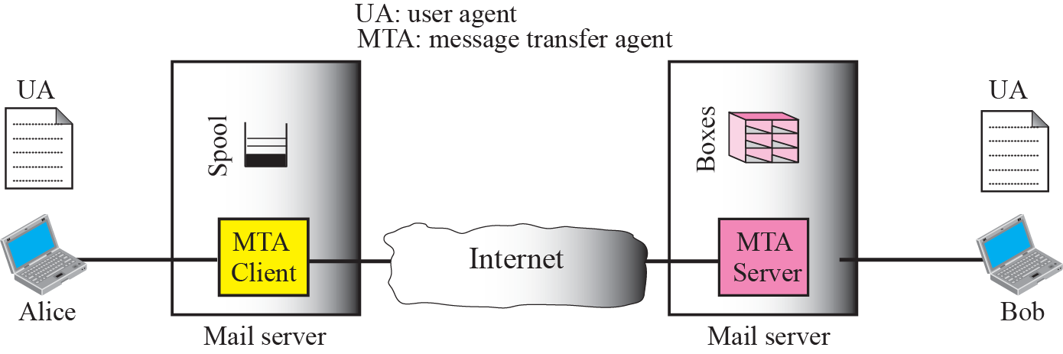
Scenario: Alice sends message to Bob

Slide 10
Sample SMTP interaction
S: 220 hamburger.edu
C: HELO crepes.fr
S: 250 Hello crepes.fr, pleased to meet you
C: MAIL FROM: <alice@crepes.fr>
S: 250 alice@crepes.fr... Sender ok
C: RCPT TO: <bob@hamburger.edu>
S: 250 bob@hamburger.edu ... Recipient ok
C: DATA
S: 354 Enter mail, end with "." on a line by itself
C: Do you like ketchup?
C: How about pickles?
C: .
S: 250 Message accepted for delivery
C: QUIT
S: 221 hamburger.edu closing connection

Slide 11
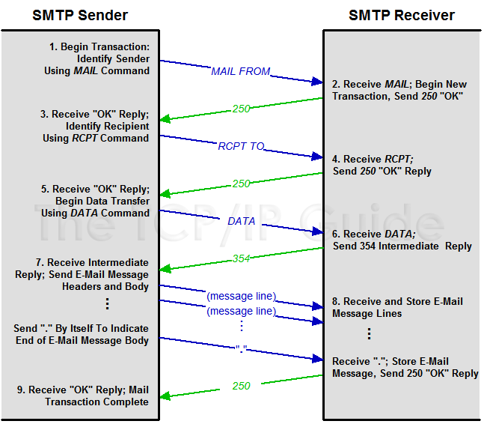
http://www.tcpipguide.com/free/t_SMTPMailTransactionProcess-3.htm

Slide 12
Try SMTP interaction for yourself:
telnet servername 25
see 220 reply from server
enter HELO, MAIL FROM, RCPT TO, DATA, QUIT commands
above lets you send email without using email client (reader)

Slide 13
SMTP: final words
SMTP uses persistent connections
SMTP requires message (header & body) to be in 7-bit ASCII
comparison with HTTP:
HTTP: pull
SMTP: push
both have ASCII command/response interaction, status codes
HTTP: each object encapsulated in its own response msg
SMTP: multiple objects sent in multipart msg

Slide 14
Mail message format
SMTP: protocol for exchanging email msgs
RFC 822: standard for text message format:
header lines, e.g.,
To:
From:
Subject:
Body: the “message”
ASCII characters only
header
blank
line
body

Slide 15
Mail access protocols
user
agent
mail access
protocol
user
agent
SMTP
SMTP
(e.g., POP,
IMAP)
sender’s mail
server
receiver’s mail
server
SMTP: delivery/storage to receiver’s server
mail access protocol: retrieval from server
POP: Post Office Protocol [RFC 1939]: authorization, download
IMAP: Internet Mail Access Protocol [RFC 1730]: more features, including manipulation of stored msgs on server
HTTP: gmail, Hotmail, Yahoo! Mail, etc.

Slide 16
POP3 protocol
S: +OK POP3 server ready
C: user bob
S: +OK
C: pass hungry
S: +OK user successfully logged on
authorization phase
client commands:
user: declare username
pass: password
server responses
+OK
-ERR
transaction phase, client:
list: list message numbers
retr: retrieve message by number
dele: delete
quit
C: list
S: 1 498
S: 2 912
S: .
C: retr 1
S: <message 1 contents>
S: .
C: dele 1
C: retr 2
S: <message 1 contents>
S: .
C: dele 2
C: quit
S: +OK POP3 server signing off

Slide 17
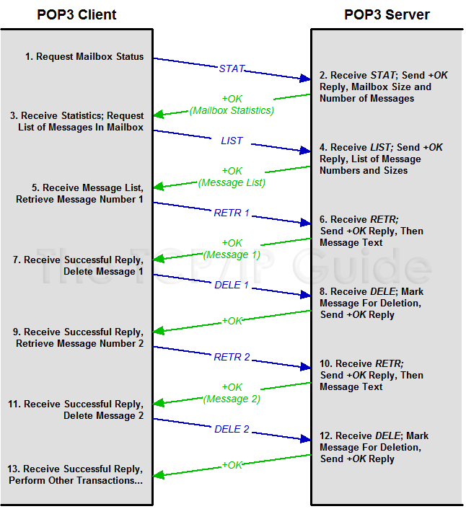

Slide 18
POP3 (more) and IMAP
more about POP3
previous example uses POP3 “download and delete” mode
Bob cannot re-read e-mail if he changes client
POP3 “download-and-keep”: copies of messages on different clients
POP3 is stateless across sessions
IMAP
keeps all messages in one place: at server
allows user to organize messages in folders
keeps user state across sessions:
names of folders and mappings between message IDs and folder name

Slide 19
Application Layer: Overview
P2P applications
video streaming and content distribution networks
socket programming with UDP and TCP
Principles of network applications
Web and HTTP
E-mail, SMTP, IMAP
The Domain Name System DNS

Slide 20
DNS: Domain Name System
people: many identifiers:
SSN, name, passport #
Internet hosts, routers:
IP address (32 bit) - used for addressing datagrams
“name”, e.g., cs.umass.edu - used by humans
Q: how to map between IP address and name, and vice versa ?
Domain Name System (DNS):
distributed database implemented in hierarchy of many name servers
application-layer protocol: hosts, DNS servers communicate to resolve names (address/name translation)
note: core Internet function, implemented as application-layer protocol
complexity at network’s “edge”

Slide 21
DNS: services, structure
DNS services:
hostname-to-IP-address translation
host aliasing
canonical, alias names
mail server aliasing
load distribution
replicated Web servers: many IP addresses correspond to one name
Q: Why not centralize DNS?
single point of failure
traffic volume
distant centralized database
maintenance
A: doesn‘t scale!
Comcast DNS servers alone: 600B DNS queries/day
Akamai DNS servers alone: 2.2T DNS queries/day

Slide 22

Thinking about the DNS
humongous distributed database:
~ billion records, each simple
handles many trillions of queries/day:
many more reads than writes
performance matters: almost every Internet transaction interacts with DNS - msecs count!
organizationally, physically decentralized:
millions of different organizations responsible for their records
“bulletproof”: reliability, security

Slide 23
DNS: a distributed, hierarchical database
Root DNS Servers
Root
…
…
.com DNS servers
.org DNS servers
.edu DNS servers
Top Level Domain
…
…
…
…
yahoo.com
DNS servers
amazon.com
DNS servers
pbs.org
DNS servers
nyu.edu
DNS servers
umass.edu
DNS servers
Authoritative
Client wants IP address for www.amazon.com; 1st approximation:
client queries root server to find .com DNS server
client queries .com DNS server to get amazon.com DNS server
client queries amazon.com DNS server to get IP address for www.amazon.com

Slide 24
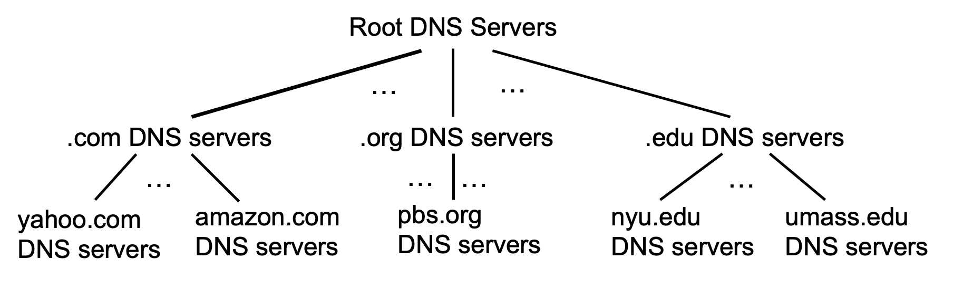
DNS: root name servers
official, contact-of-last-resort by name servers that can not resolve name

Slide 25
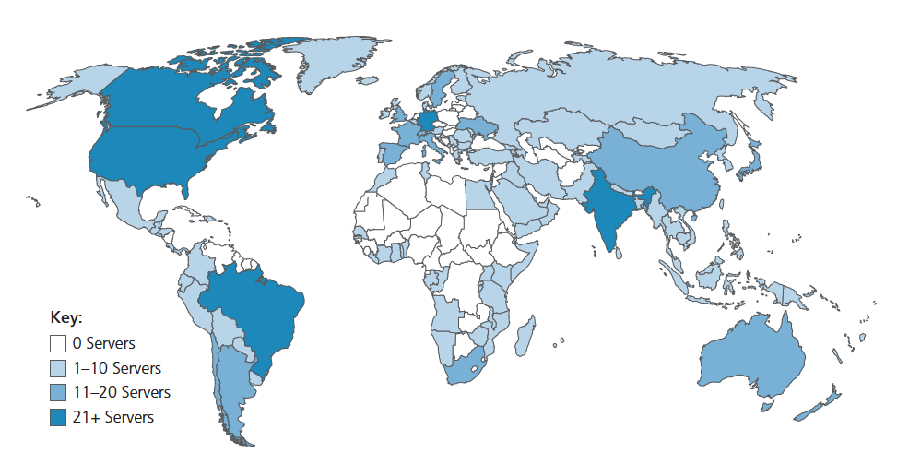
DNS: root name servers
official, contact-of-last-resort by name servers that can not resolve name
incredibly important Internet function
Internet couldn’t function without it!
Remember Facebook outage a couple of days ago
DNSSEC – provides security (authentication, message integrity)
ICANN (Internet Corporation for Assigned Names and Numbers) manages root DNS domain
13 logical root name “servers” worldwide each “server” replicated many times (~200 servers in US)

Slide 26
Top-Level Domain, and authoritative servers
Top-Level Domain (TLD) servers:
responsible for .com, .org, .net, .edu, .aero, .jobs, .museums, and all top-level country domains, e.g.: .cn, .uk, .fr, .ca, .jp
Network Solutions: authoritative registry for .com, .net TLD
Educause: .edu TLD
authoritative DNS servers:
organization’s own DNS server(s), providing authoritative hostname to IP mappings for organization’s named hosts
can be maintained by organization or service provider

Slide 27
Local DNS name servers
when host makes DNS query, it is sent to its local DNS server
Local DNS server returns reply, answering:
from its local cache of recent name-to-address translation pairs (possibly out of date!)
forwarding request into DNS hierarchy for resolution
each ISP has local DNS name server; to find yours:
MacOS: % scutil --dns
Windows: >ipconfig /all
local DNS server doesn’t strictly belong to hierarchy

Slide 28
DNS name resolution: iterated query
root DNS server
Example: host at engineering.nyu.edu wants IP address for gaia.cs.umass.edu
2
3
TLD DNS server
Iterated query:
contacted server replies with name of server to contact
“I don’t know this name, but ask this server”
1
4
8
5
requesting host at
engineering.nyu.edu
local DNS server
dns.nyu.edu
gaia.cs.umass.edu
7
6
authoritative DNS server
dns.cs.umass.edu

Slide 29
DNS name resolution: recursive query
root DNS server
Example: host at engineering.nyu.edu wants IP address for gaia.cs.umass.edu
2
3
7
6
Recursive query:
puts burden of name resolution on contacted name server
heavy load at upper levels of hierarchy?
1
TLD DNS server
8
requesting host at
engineering.nyu.edu
local DNS server
dns.nyu.edu
5
4
gaia.cs.umass.edu
authoritative DNS server
dns.cs.umass.edu

Slide 30
DNS records
DNS: distributed database storing resource records (RR)
RR format: (name, value, type, ttl)
type=A
name is hostname
value is IP address
type=CNAME
name is alias name for some “canonical” (the real) name
www.ibm.com is really servereast.backup2.ibm.com
value is canonical name
type=NS
name is domain (e.g., foo.com)
value is hostname of authoritative name server for this domain
type=MX
value is name of SMTP mail server associated with name

Slide 31
DNS protocol messages
DNS query and reply messages, both have same format:
2 bytes
2 bytes
message header:
identification: 16 bit # for query, reply to query uses same #
flags:
query or reply
recursion desired
recursion available
reply is authoritative
identification
flags
# questions
# answer RRs
# authority RRs
# additional RRs
questions (variable # of questions)
answers (variable # of RRs)
authority (variable # of RRs)
additional info (variable # of RRs)

Slide 32
DNS protocol messages
DNS query and reply messages, both have same format:
2 bytes
2 bytes
identification
flags
# questions
# answer RRs
# authority RRs
# additional RRs
name, type fields for a query
questions (variable # of questions)
RRs in response to query
answers (variable # of RRs)
records for authoritative servers
authority (variable # of RRs)
additional “ helpful” info that may be used
additional info (variable # of RRs)

Slide 33
Getting your info into the DNS
example: new startup “Network Utopia”
register name networkuptopia.com at DNS registrar (e.g., Network Solutions)
provide names, IP addresses of authoritative name server (primary and secondary)
registrar inserts NS, A RRs into .com TLD server:
(networkutopia.com, dns1.networkutopia.com, NS)
(dns1.networkutopia.com, 212.212.212.1, A)
create authoritative server locally with IP address 212.212.212.1
type A record for www.networkuptopia.com
type MX record for networkutopia.com

Slide 34
Caching DNS Information
once (any) name server learns mapping, it caches mapping, and immediately returns a cached mapping in response to a query
caching improves response time
cache entries timeout (disappear) after some time (TTL)
TLD servers typically cached in local name servers
cached entries may be out-of-date
if named host changes IP address, may not be known Internet-wide until all TTLs expire!
best-effort name-to-address translation!

Slide 35
DNS security
DDoS attacks
bombard root servers with traffic
not successful to date
traffic filtering
local DNS servers cache IPs of TLD servers, allowing root server bypass
bombard TLD servers
potentially more dangerous
Spoofing attacks
intercept DNS queries, returning bogus replies
DNS cache poisoning
RFC 4033: DNSSEC authentication services

Slide 36
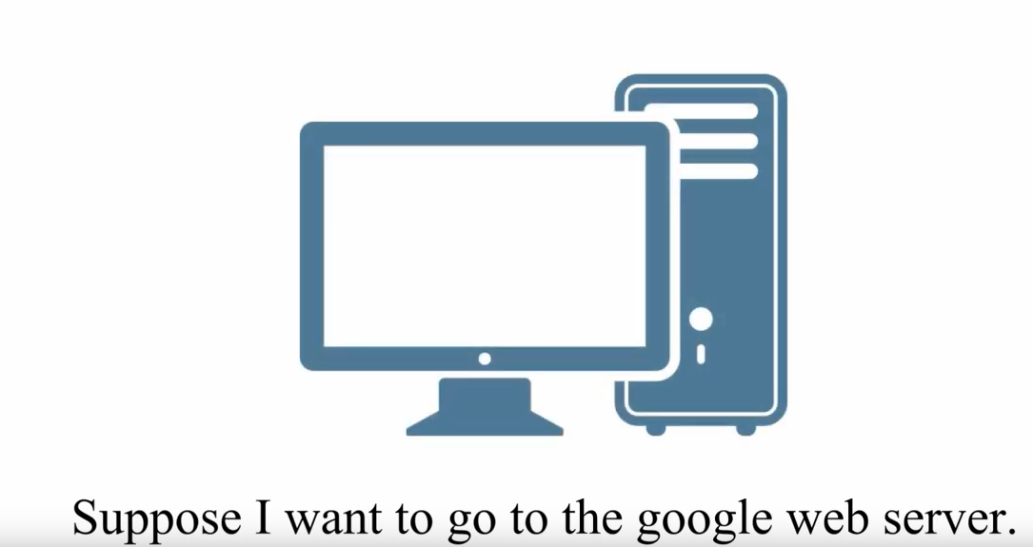
DNS walkthrough

Slide 37
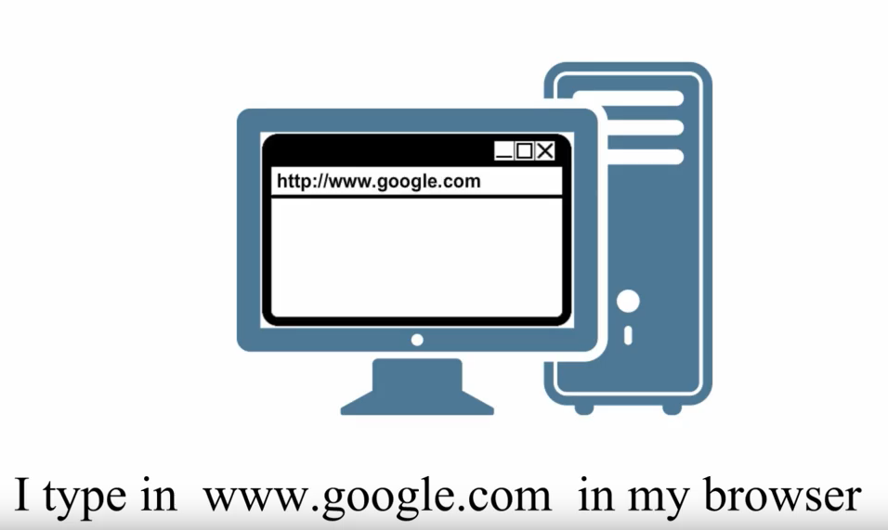
DNS walkthrough

Slide 38
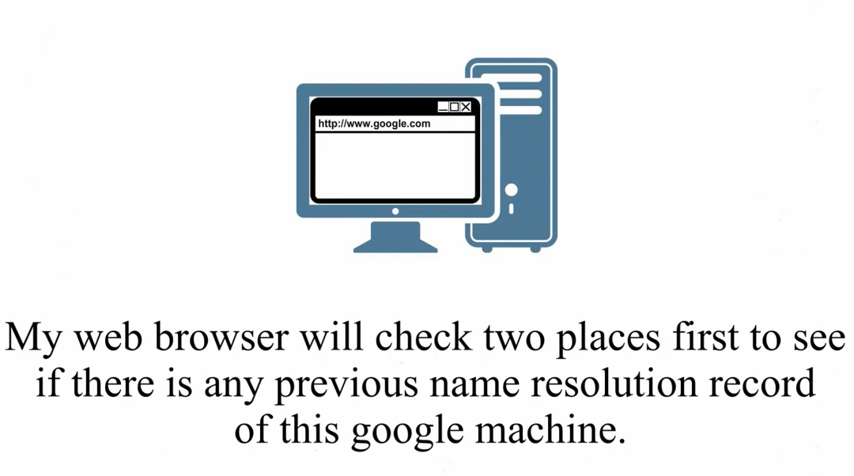
DNS walkthrough

Slide 39
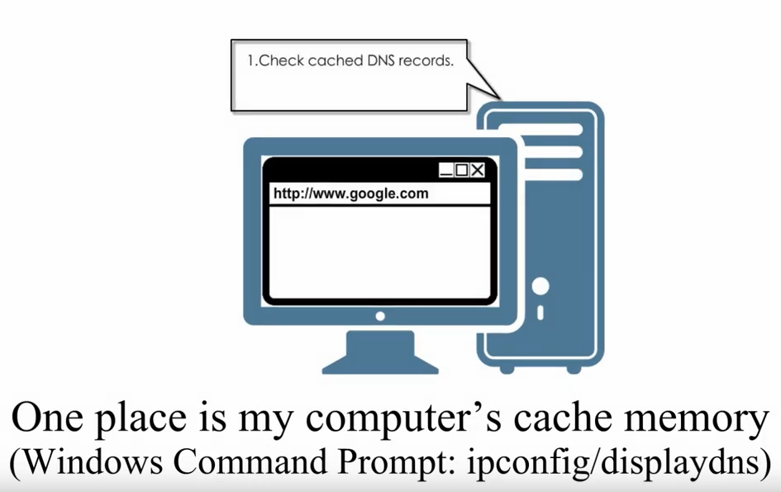
DNS walkthrough

Slide 40
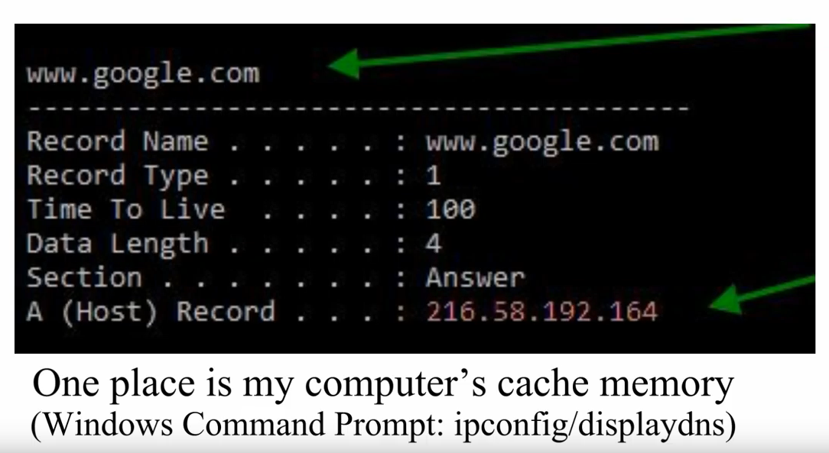
DNS walkthrough

Slide 41
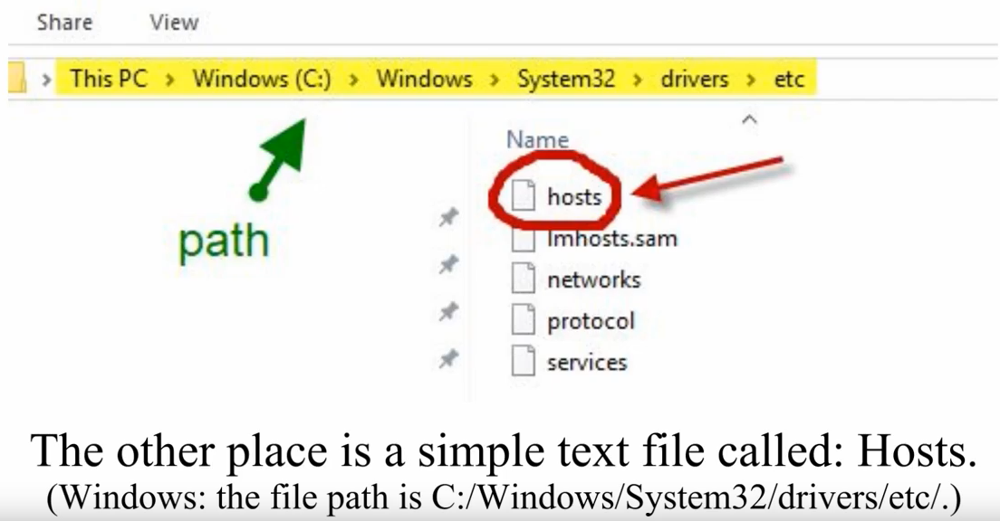
DNS walkthrough

Slide 42
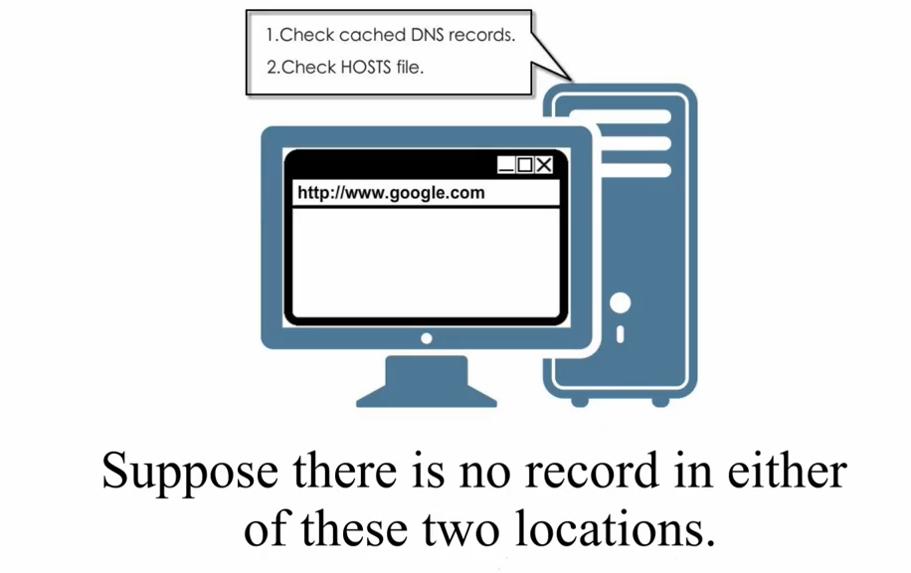
DNS walkthrough

Slide 43
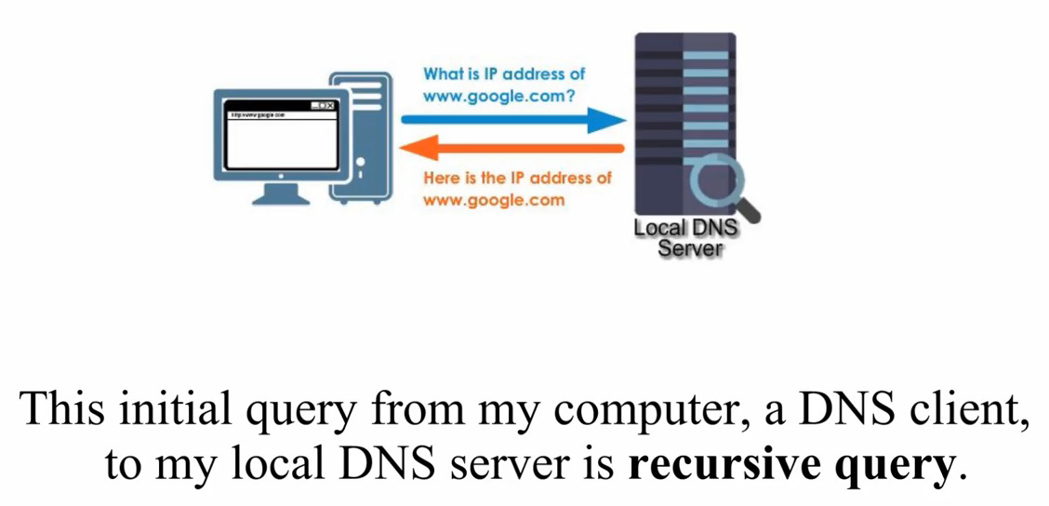
DNS walkthrough

Slide 44
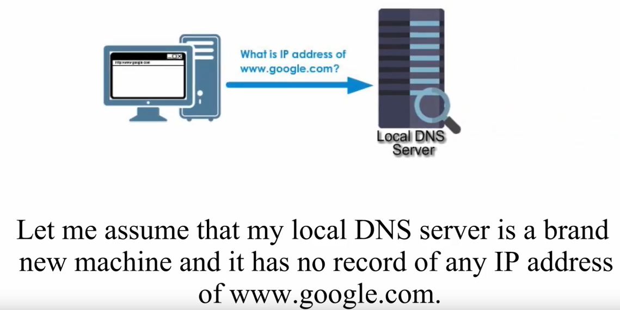
DNS walkthrough

Slide 45
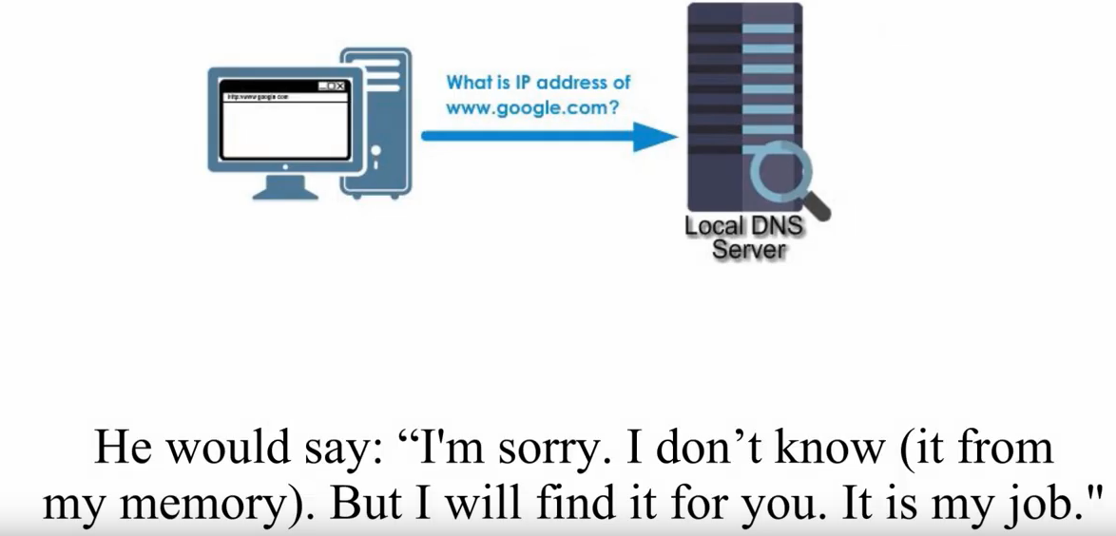
DNS walkthrough

Slide 46
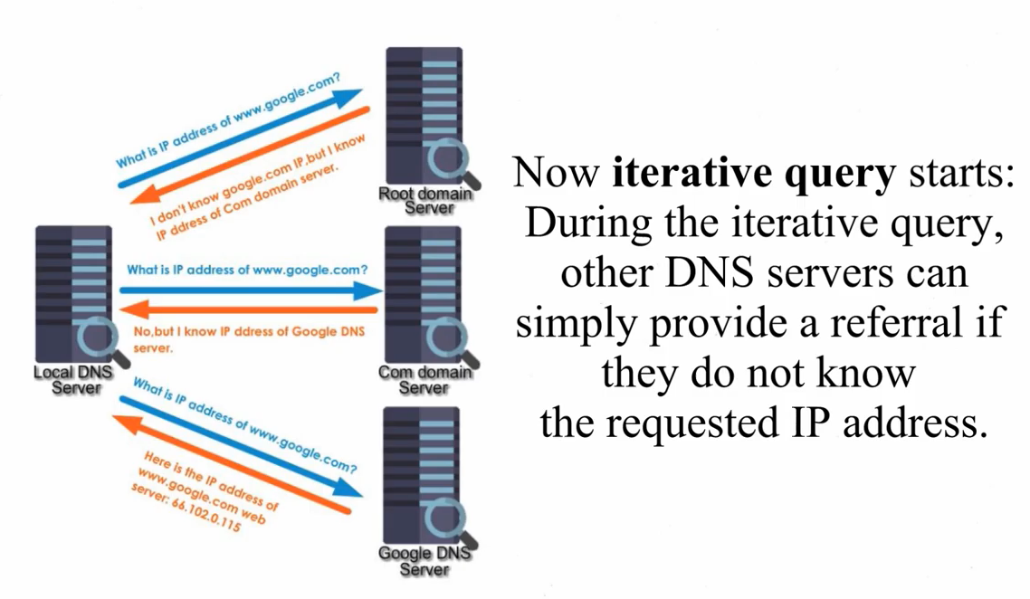
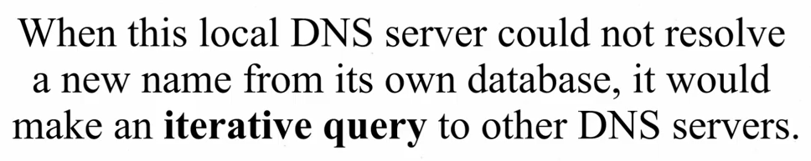
DNS walkthrough

Slide 47
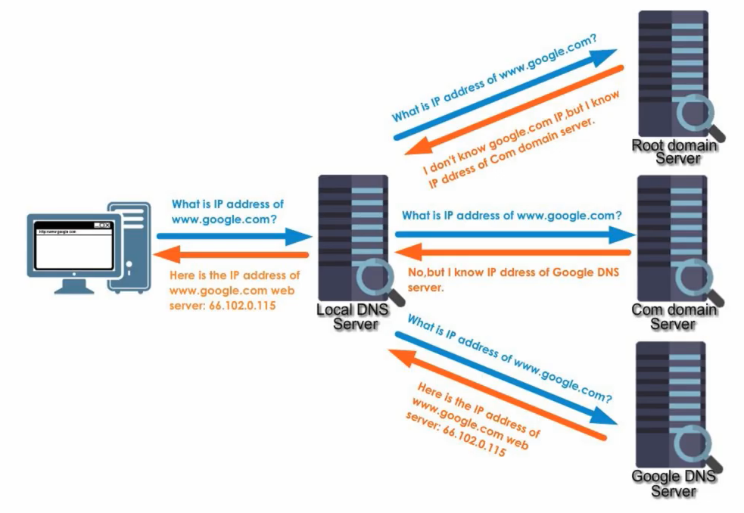
DNS walkthrough

Slide 48
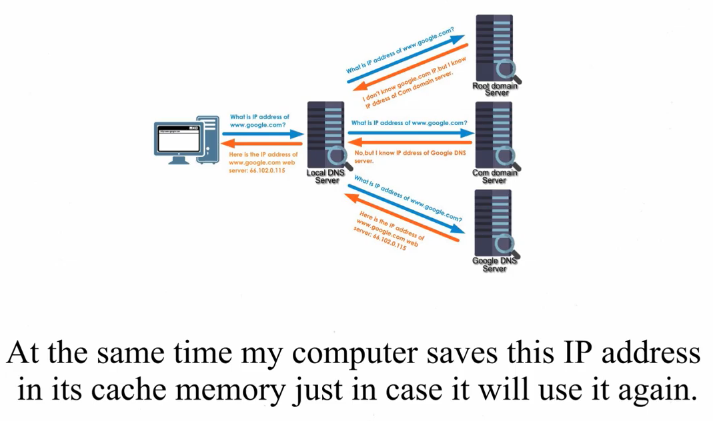
DNS walkthrough

Slide 49
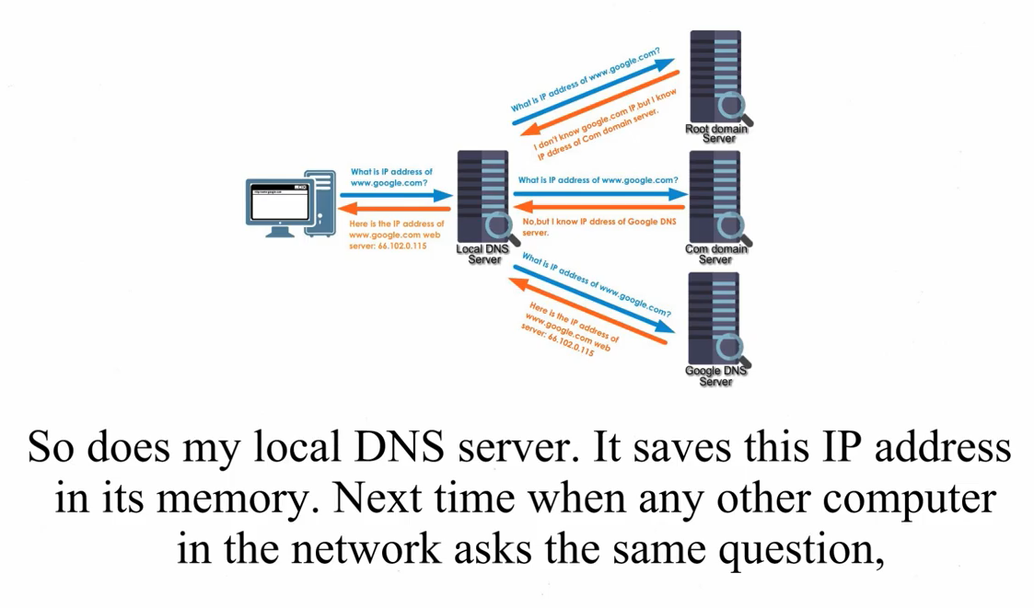
DNS walkthrough

